Slide 1
Chapter 3 Second order linear differential equations
Prof. Pham Huu Anh Ngoc Department of Mathematics

Slide 4
Example

Slide 5
HOMOGENEOUS EQUATIONS
The set of all solutions of (7) is a vector space:
*If y_1, y_2 are solutions of (7), then so is y_1+y_2.
* If y is a solution of (7), then so is cy.

Slide 6
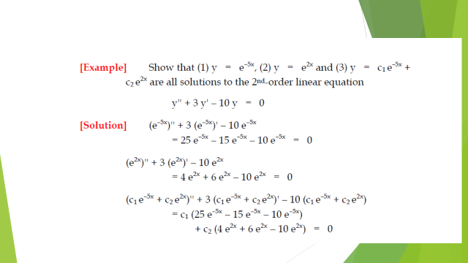

Slide 8
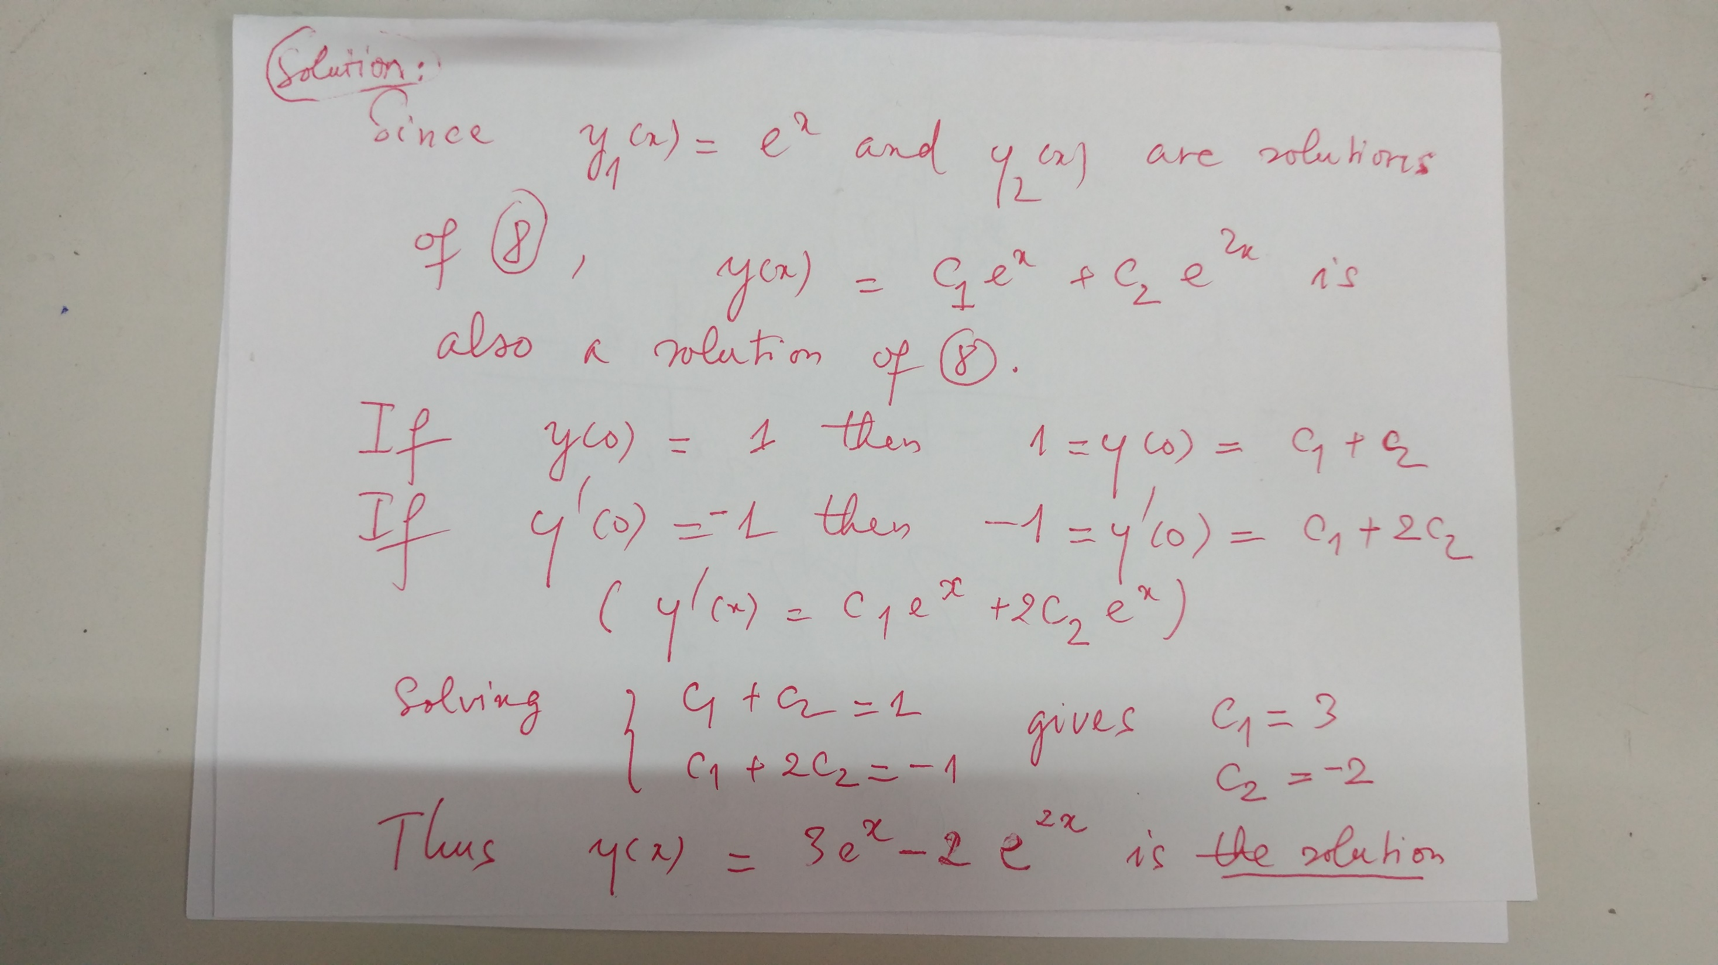
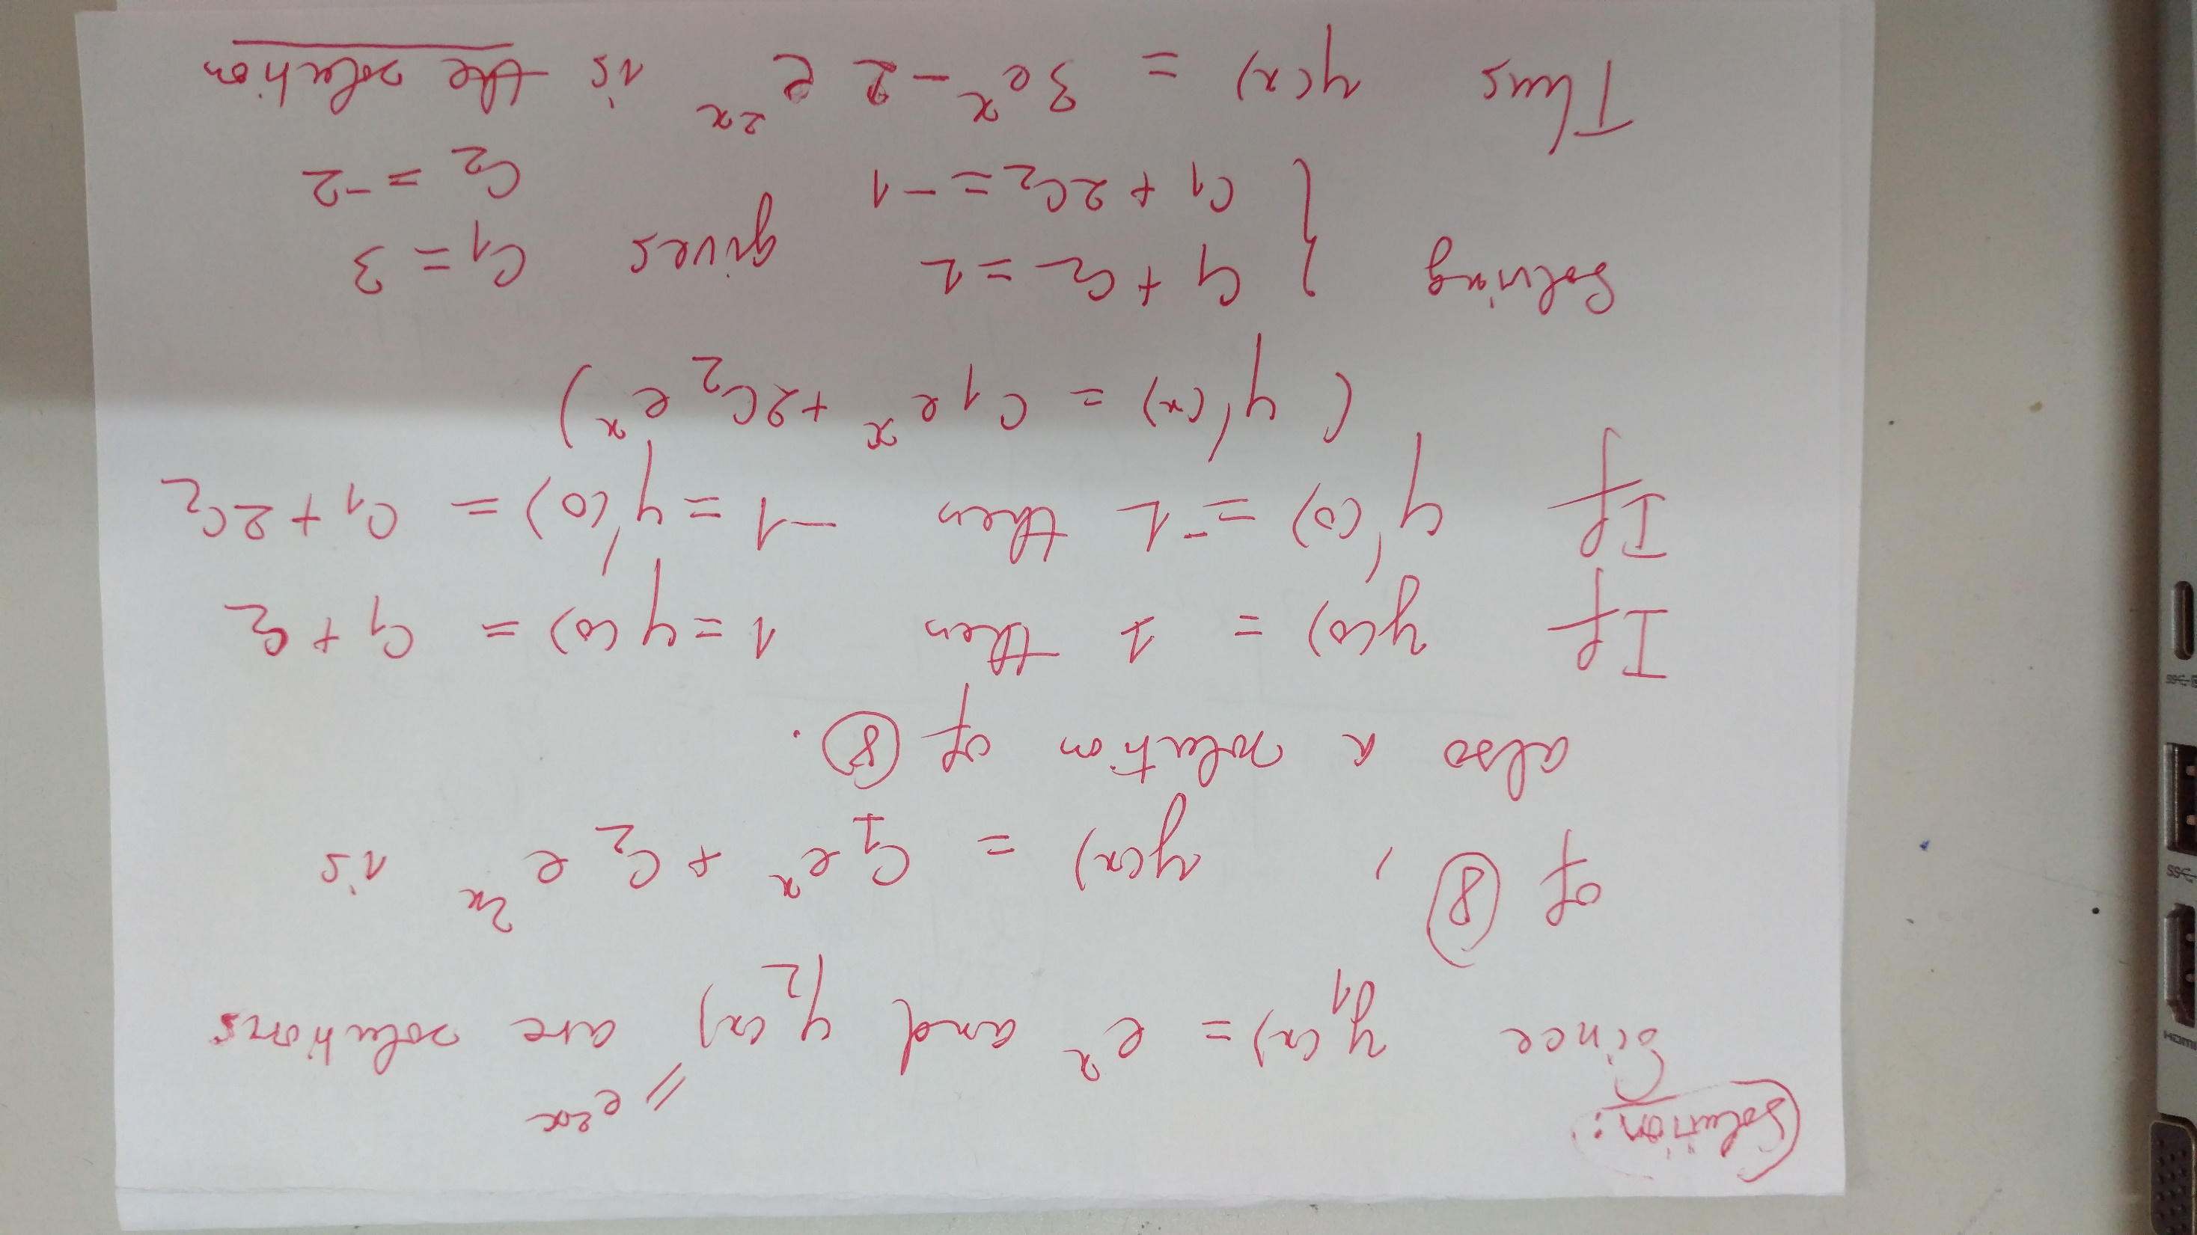

Slide 11
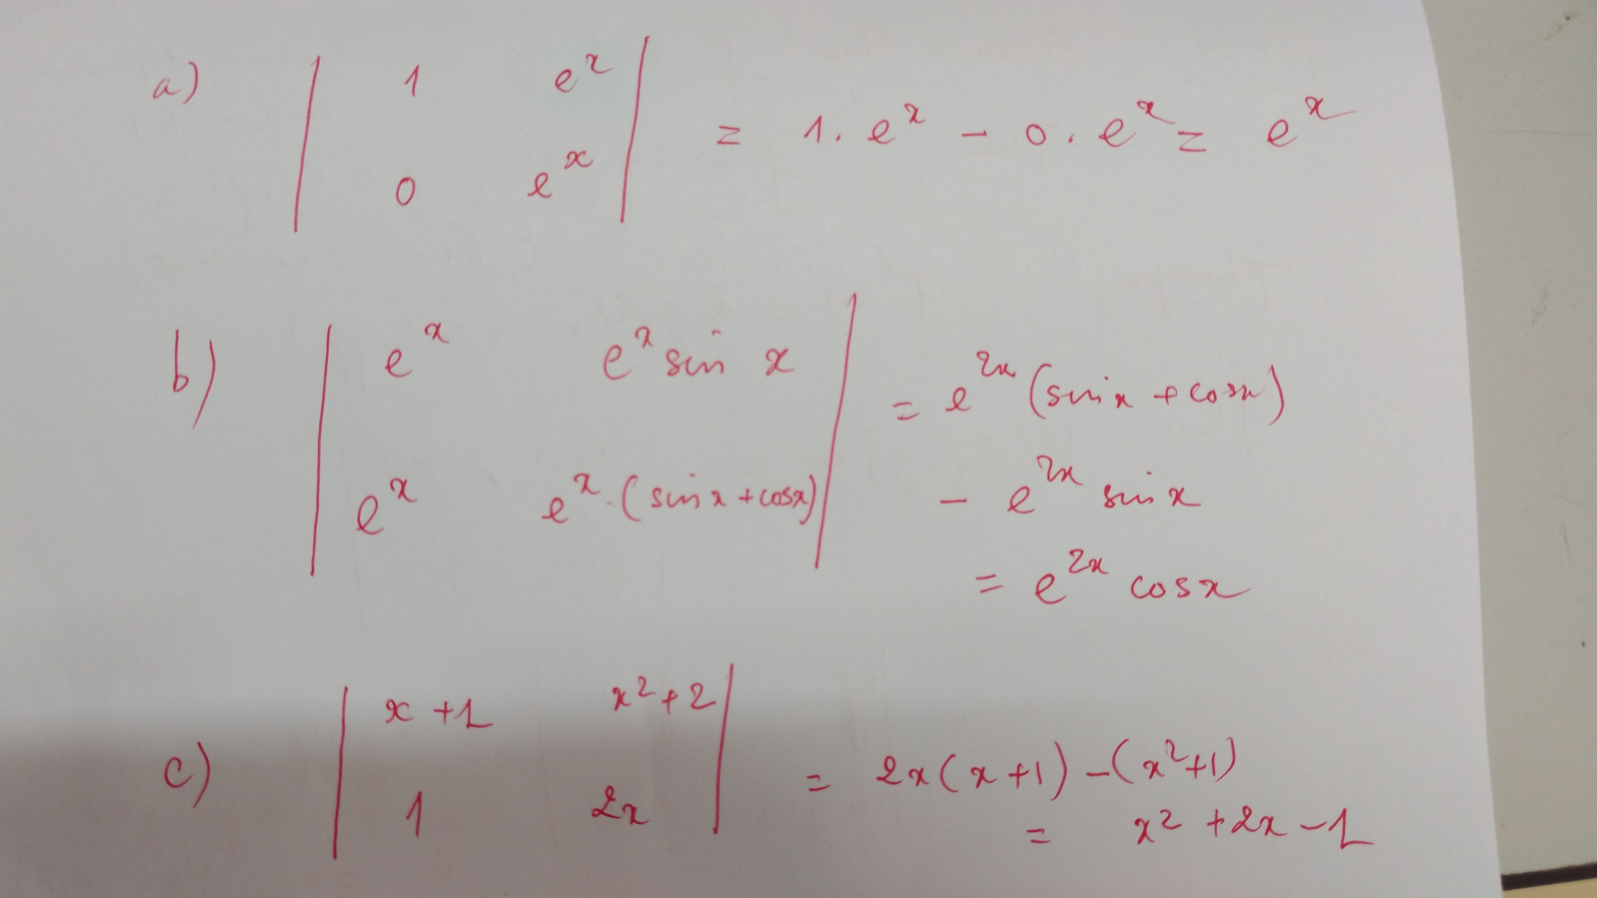

Slide 15
REMARK:
If f and g are linearly dependent on (a,b) then
f(x)=k.g(x), x in (a,b)
(k is a constant)

Slide 16
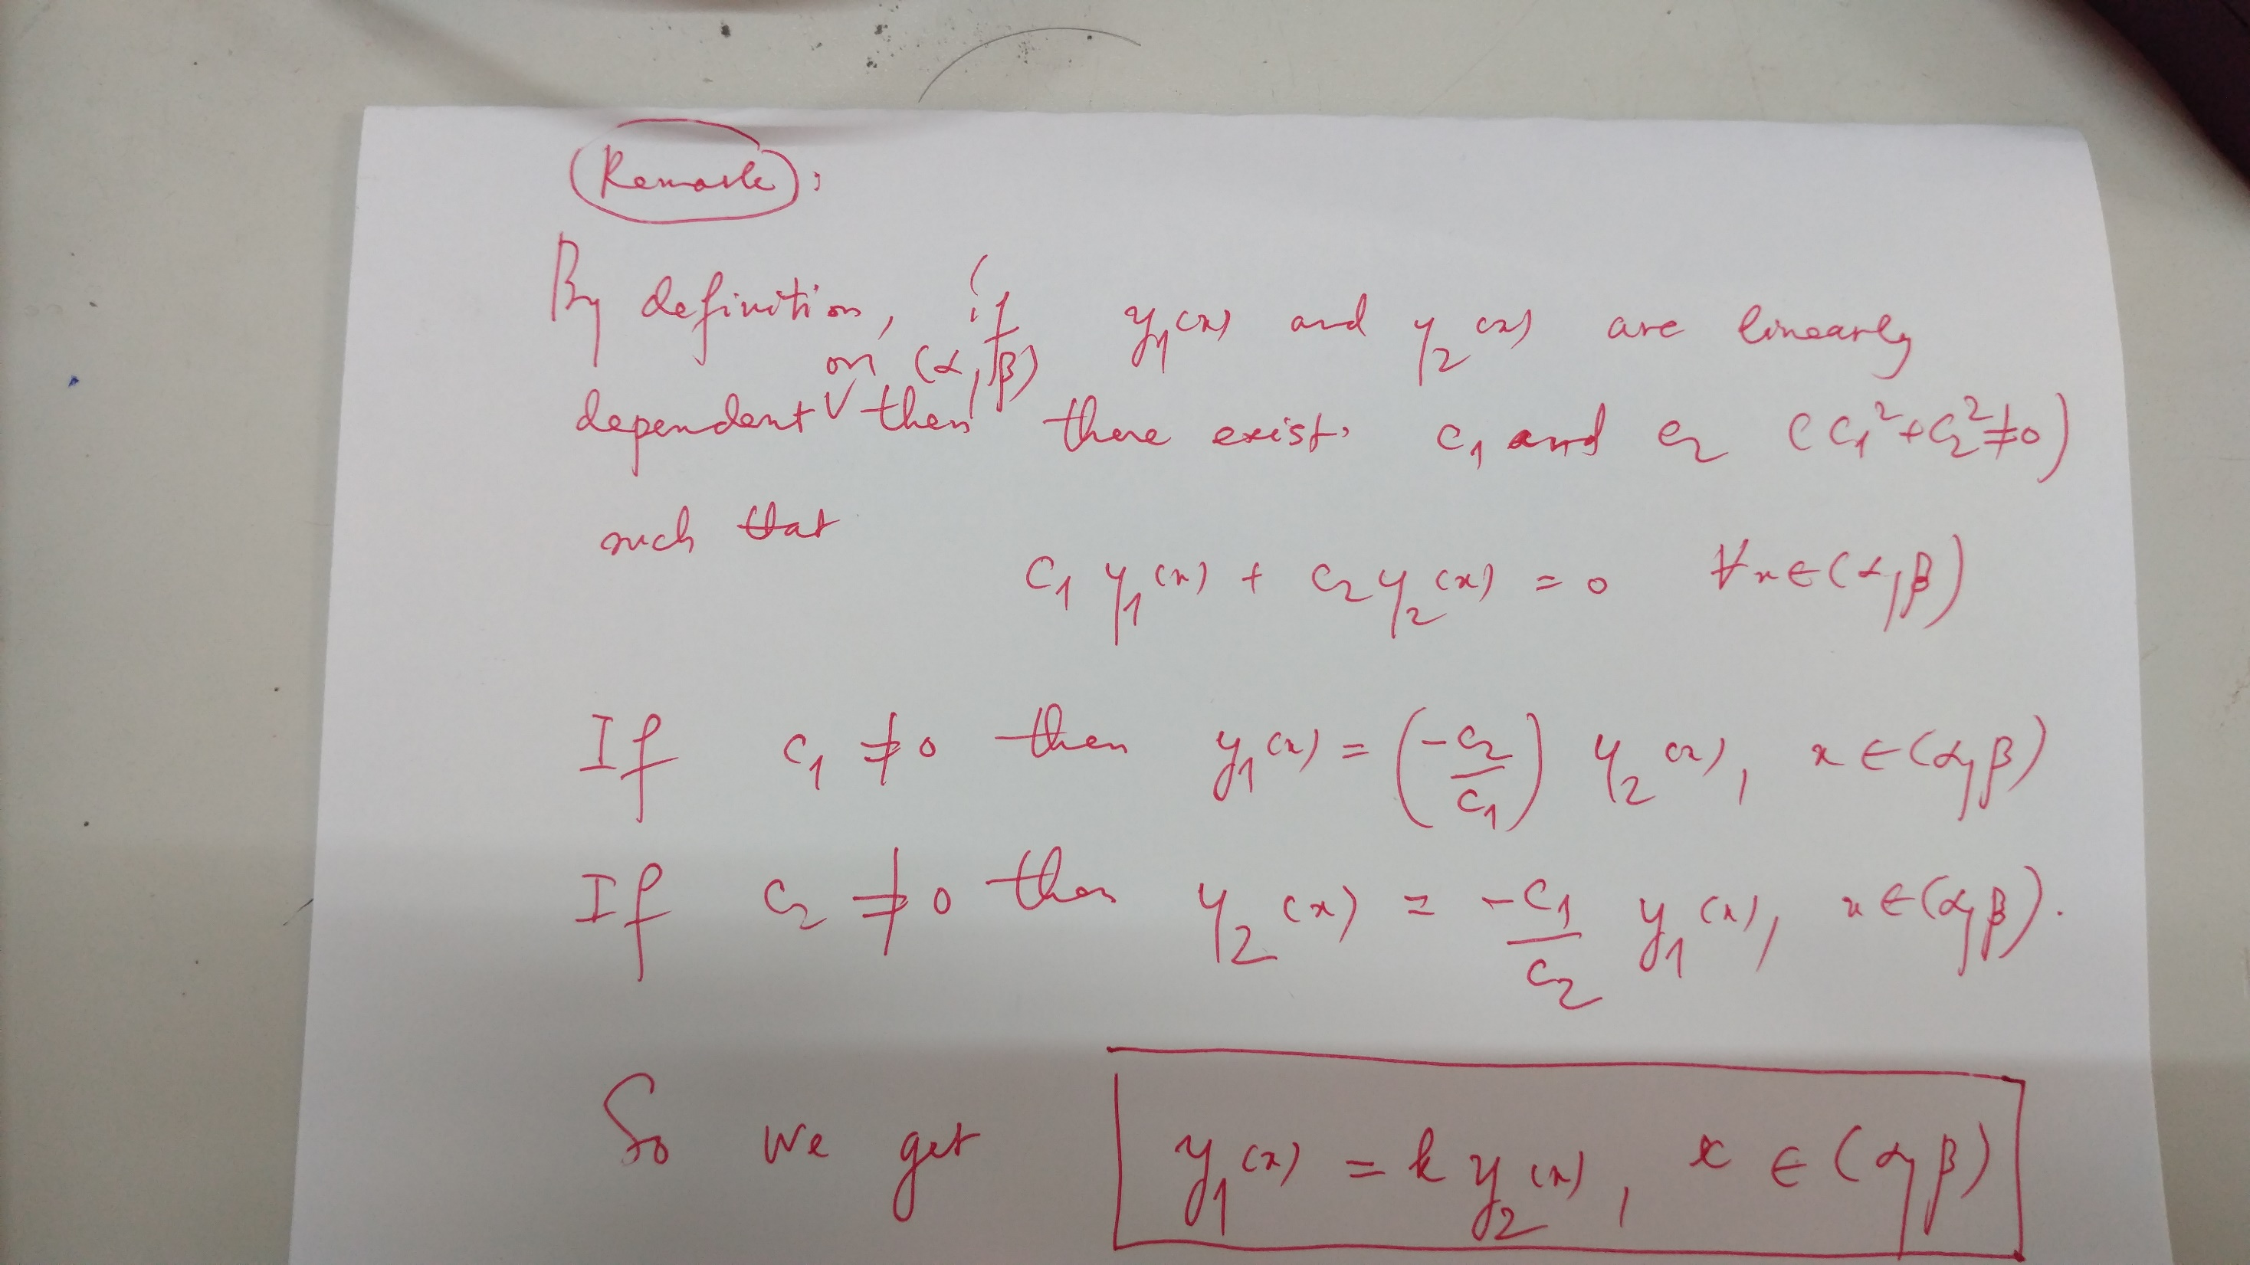

Slide 18
How to prove that
e^x, e^{2x} are linearly independent.
Assume that
c_1 e^x+c_2e^{2x}=0, for all x.
We show that c_1=c_2=0. Then e^x, e^{2x} are linearly independent.
How to prove it?
When x=0, we have
c_1+c_2=0 (1)
When x=1, we get e c_1 +e^2 c_2=0 (2)
Solving (1)-(2) gives c_1=c_2=0.

Slide 20
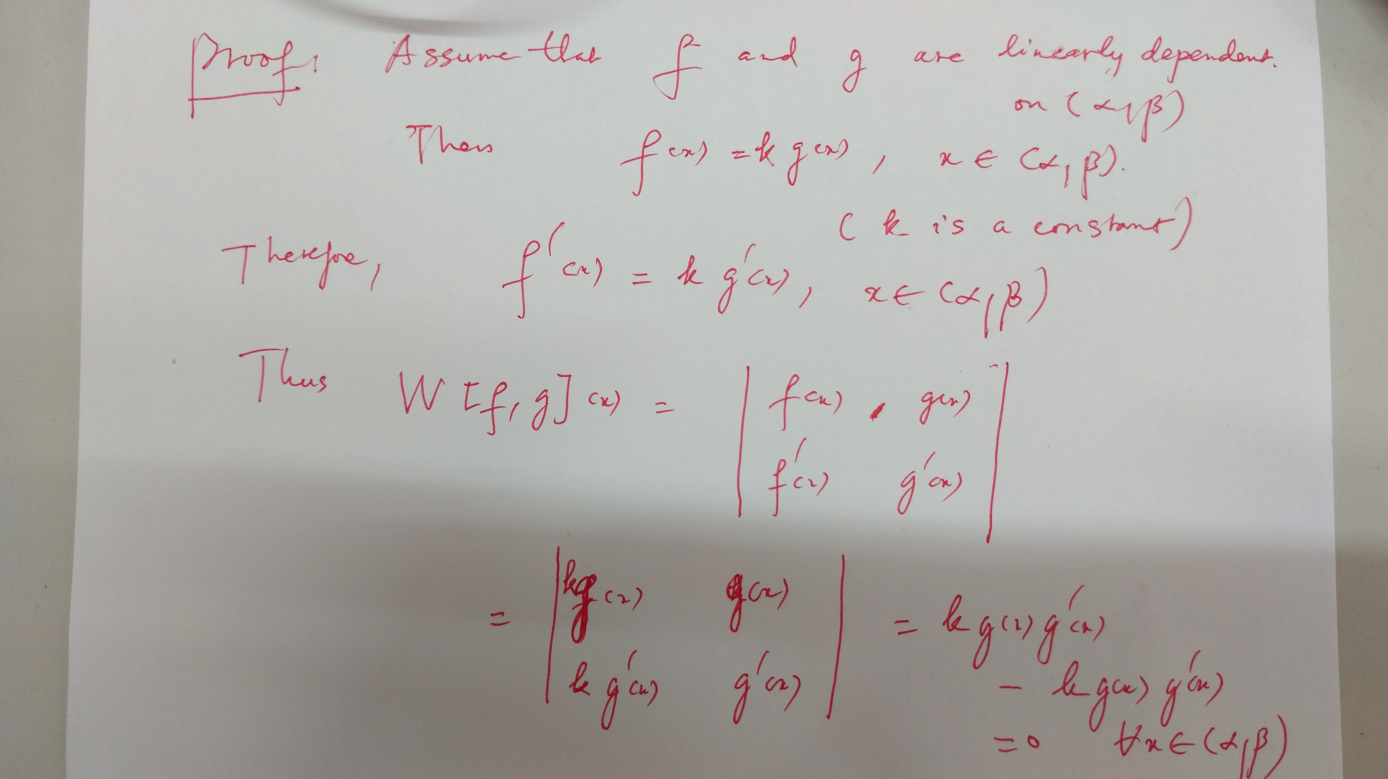
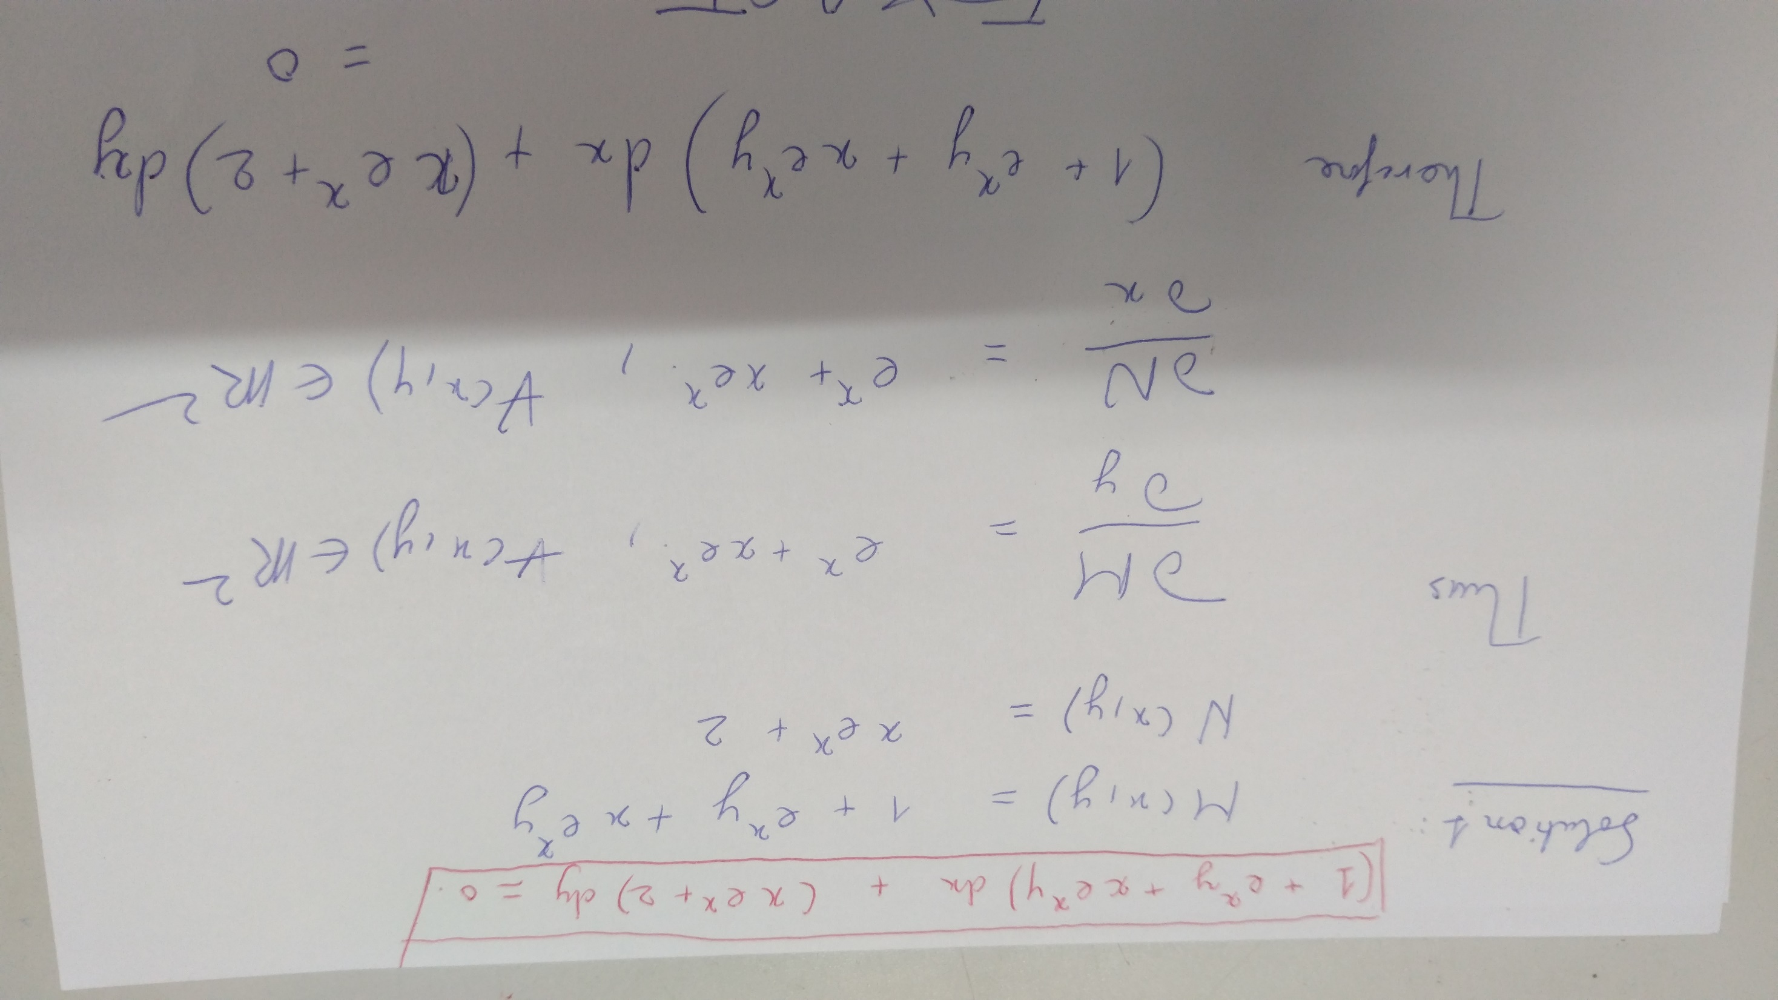

Slide 23
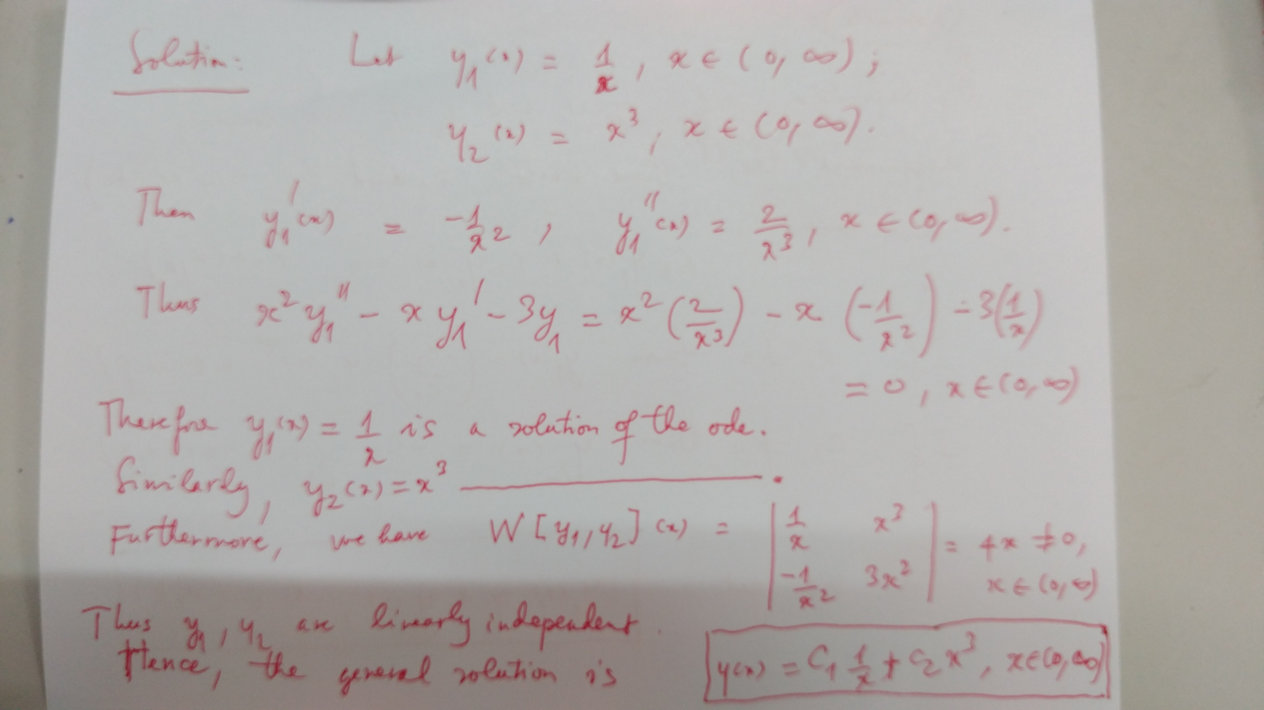

Slide 37
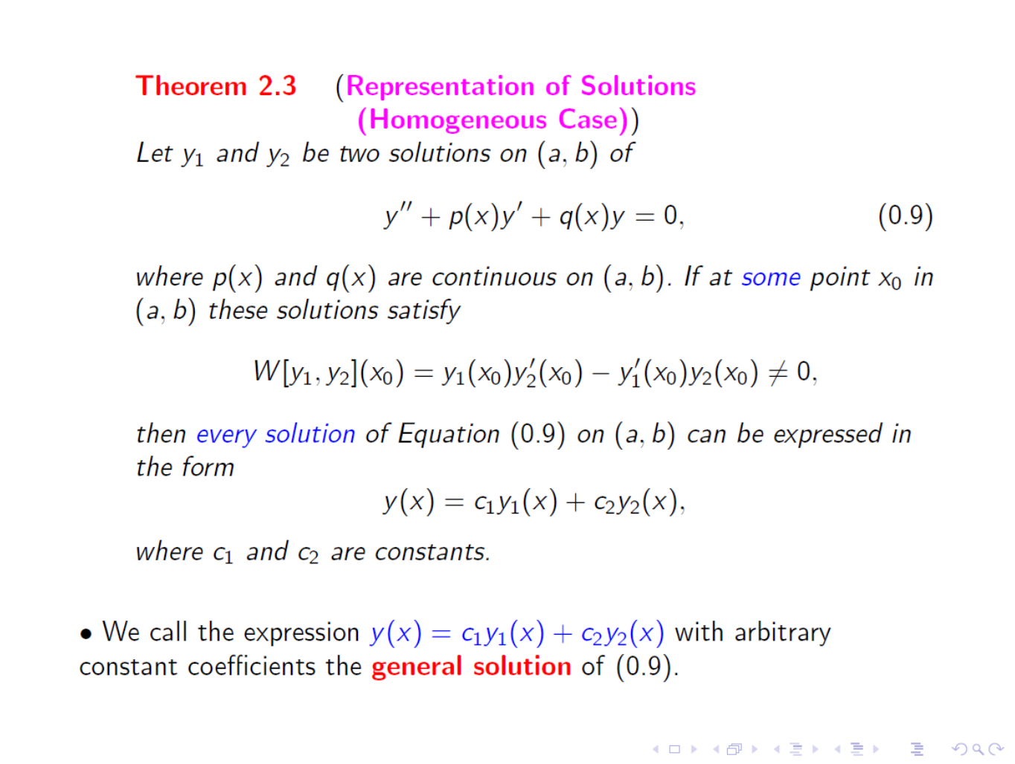

Slide 38
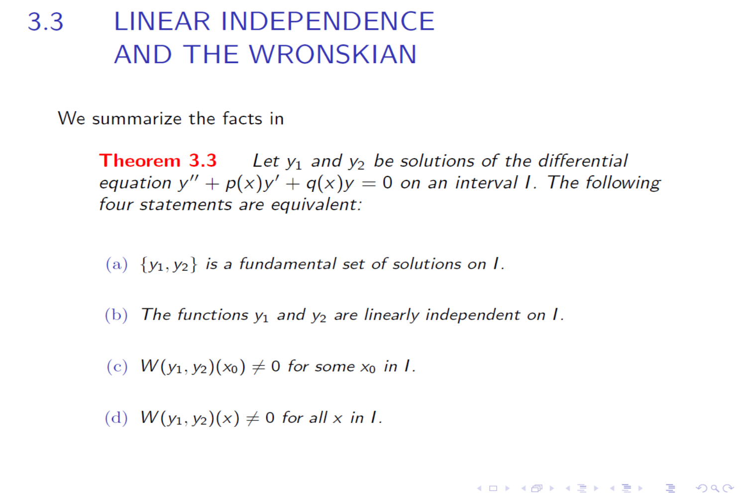

Slide 39
determined

Slide 40
So we get two solutions of the given differential equation:
y_1(x)=1/x and y_2(x)=x^4
Moreover,
W[y_1,y_2](x)=5x^2
is not equal to 0 for any x in (-infty, 0) and in (0, infty).
So y_1(x)=1/x and y_2(x)=x^4 are linearly independent on
(-infty, 0) and (0, infty).
Thus, the general solution is
y(x)=c_1(1/x)+c_2 x^4,
where x belongs to (-infty, 0) or (0, infty).

Slide 41
(16) then we can construct the second solution y_2(x):
Furthermore, y_1(x) and y_2(x) are linearly independent.

Slide 44
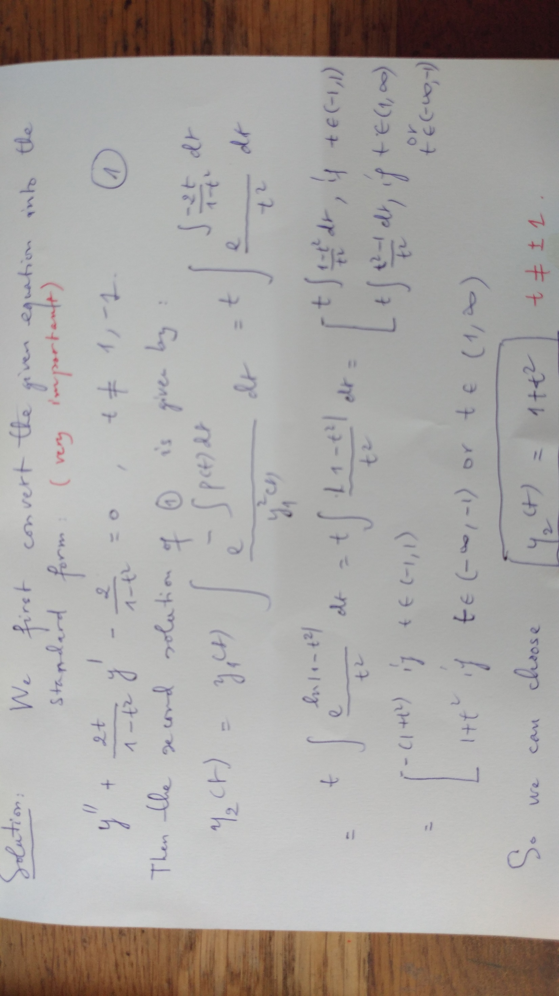

Slide 45
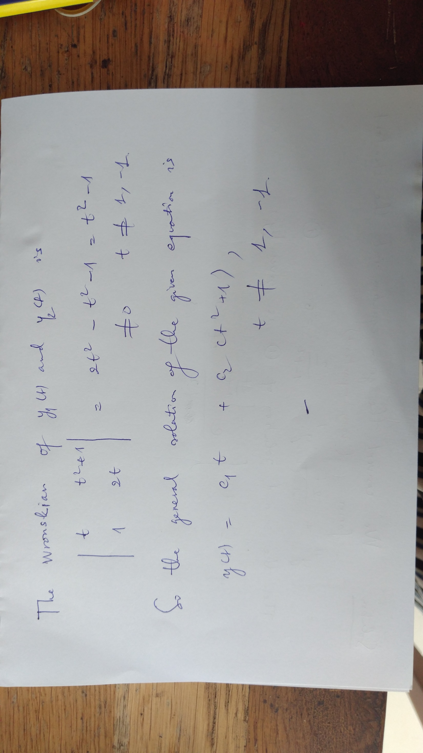

Slide 52
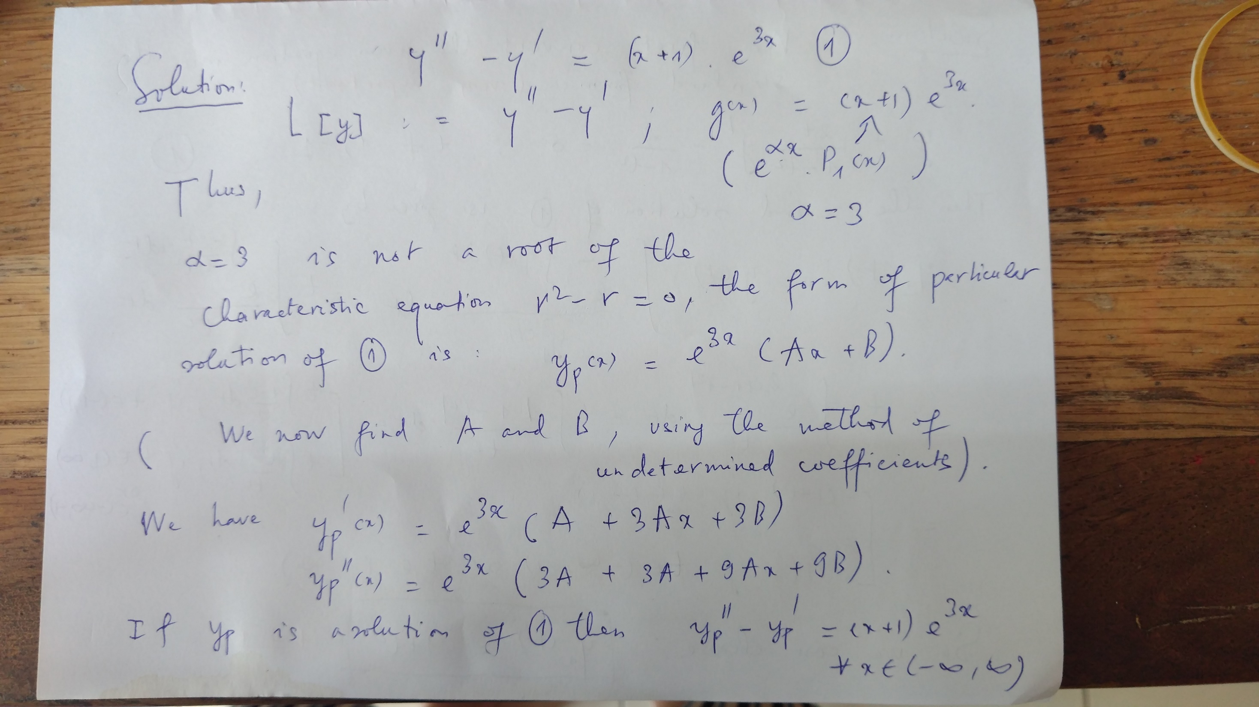

Slide 53
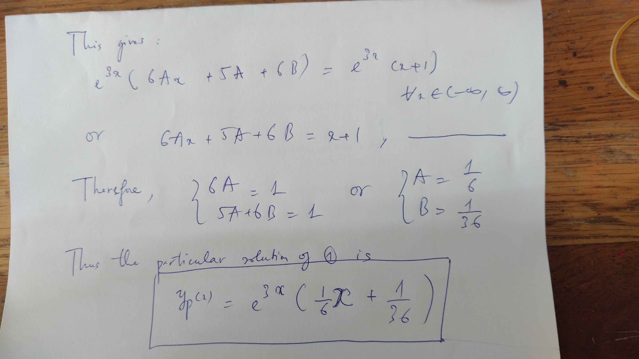

Slide 54
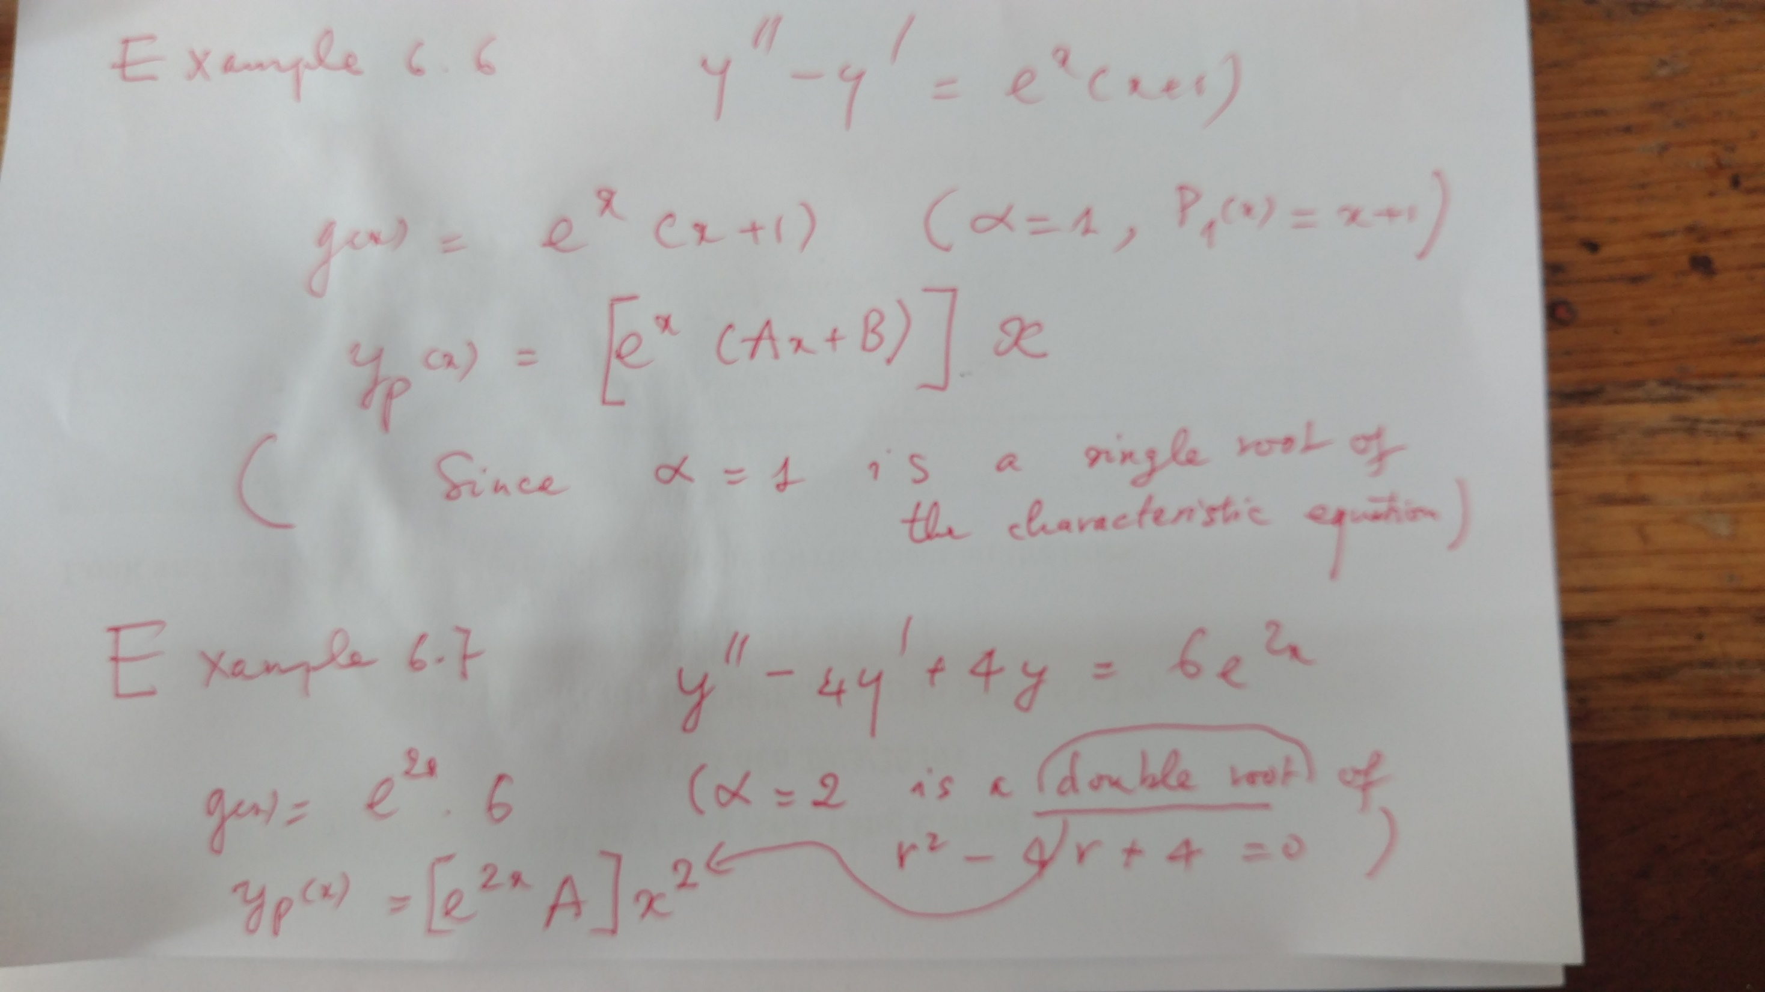

Slide 58
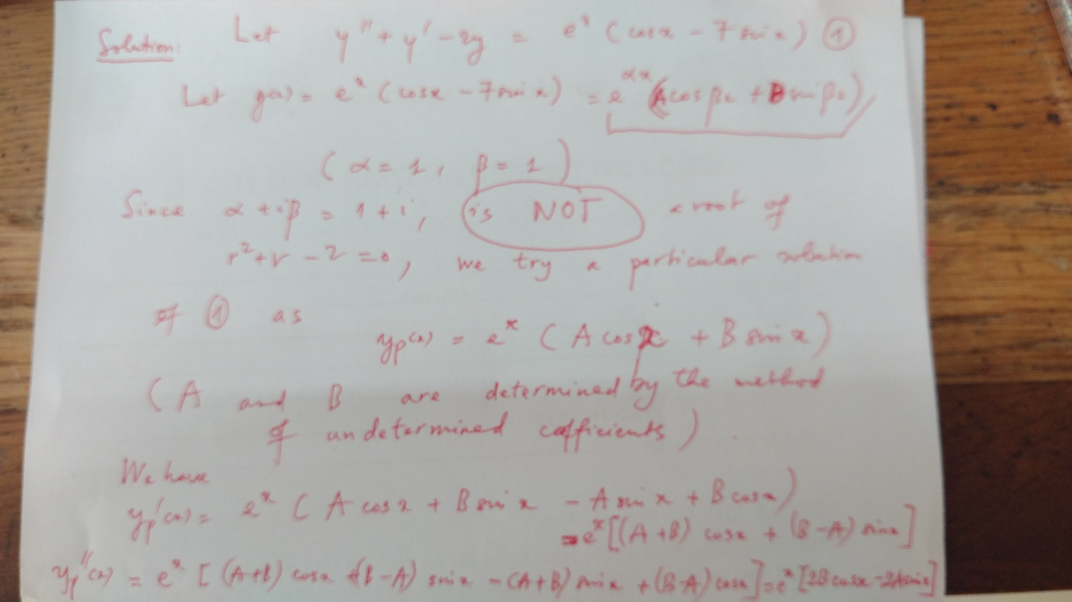

Slide 59
